Slide 1
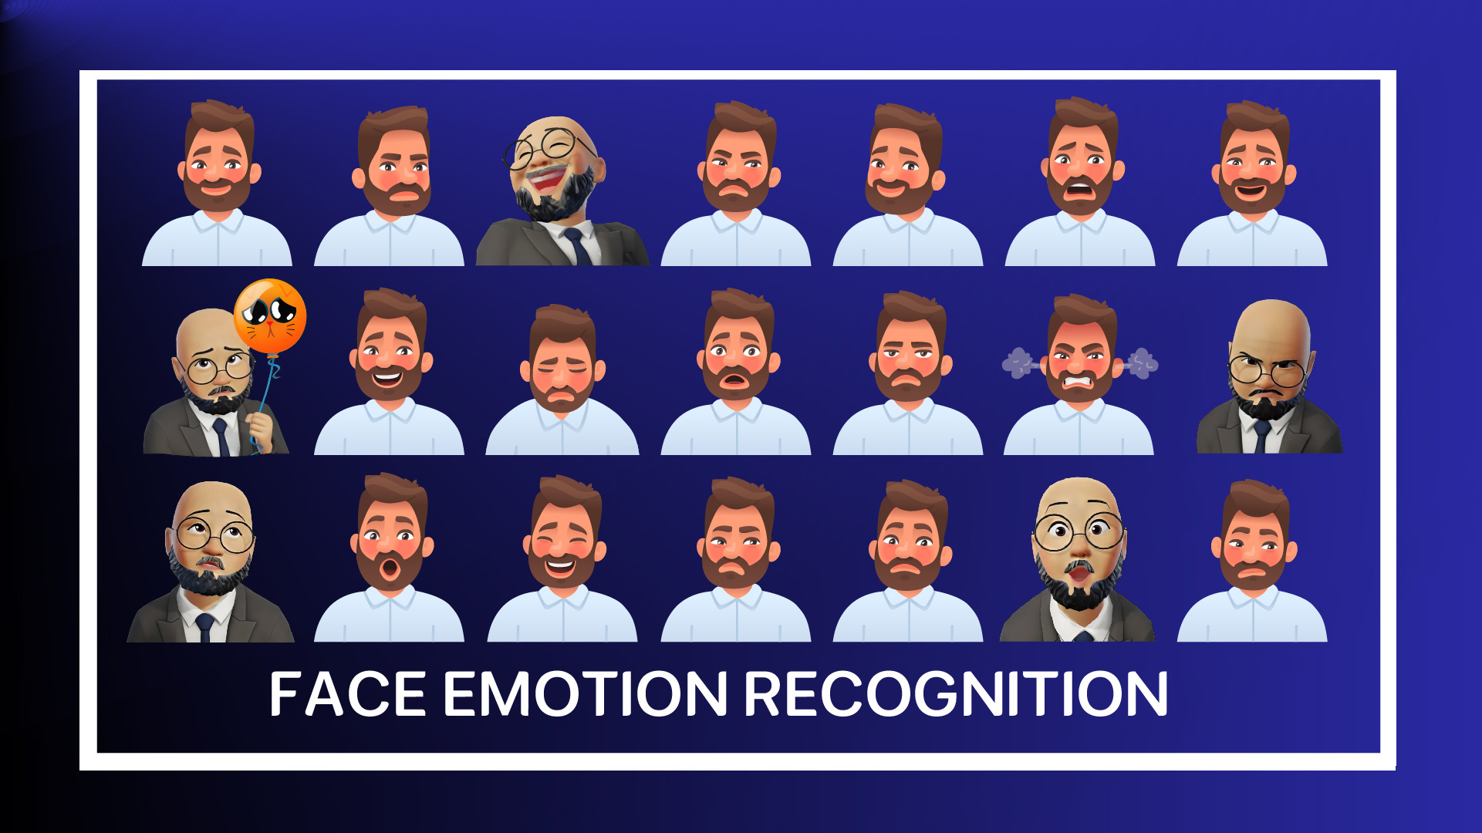

Slide 2










Our Team
Abdelrahman
Mostafa
Kamal
Ahmed Mohamed
SalahEldin
Mohamed Khaled
Hosny
Khaled Mahmoud Khaled
Mohamed Moawad
Ahmed
Ziad Mohamed
Abdelrahim
Sara Mohamed
Yousef
(2000117)
(1901084)
(2000630)
(2000676)
(2000186)
(2000758)
(2000395)
Supervised By:
DR.Hanna Bayomi
TA.Engy Emad

Slide 3




Agenda
01
Introduction
02
Motivation
03
Problem Definition
04
Methodology
05
Related Work
06
Future Work
07
Conclusion

Slide 4

Introduction
Face emotion recognition is a pioneering technology that uses artificial intelligence and machine learning to analyze facial expressions and understand human emotional states. Relying on deep learning algorithms and neural networks, it can identify emotions like happiness, sadness, anger, surprise, fear, and disgust. This technology has wide-ranging applications in fields such as healthcare, marketing, education, and security, enhancing human-machine interaction and offering deeper insights into human emotions.

Slide 5
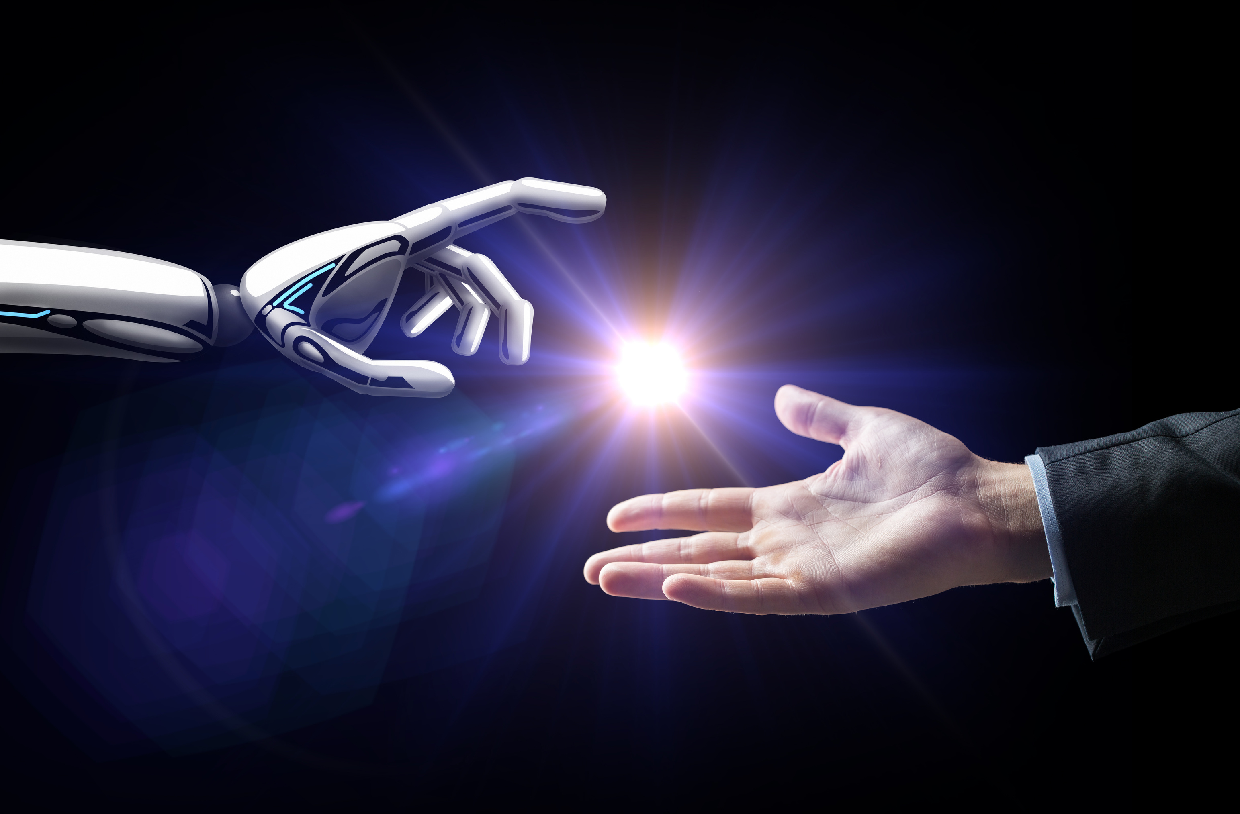
Motivation
Facial Emotion Recognition (FER) is useful for many domains. It makes computers and devices more friendly by sensing and reacting to human emotions. It helps psychologists and neuroscientists study and measure emotions and expressions. It also improves security systems by identifying people’s emotional states and detecting suspicious faces.
The motivation for applying Facial Expression Recognition (FER) technology spans various domains and purposes. Here are some key motivations

Slide 6
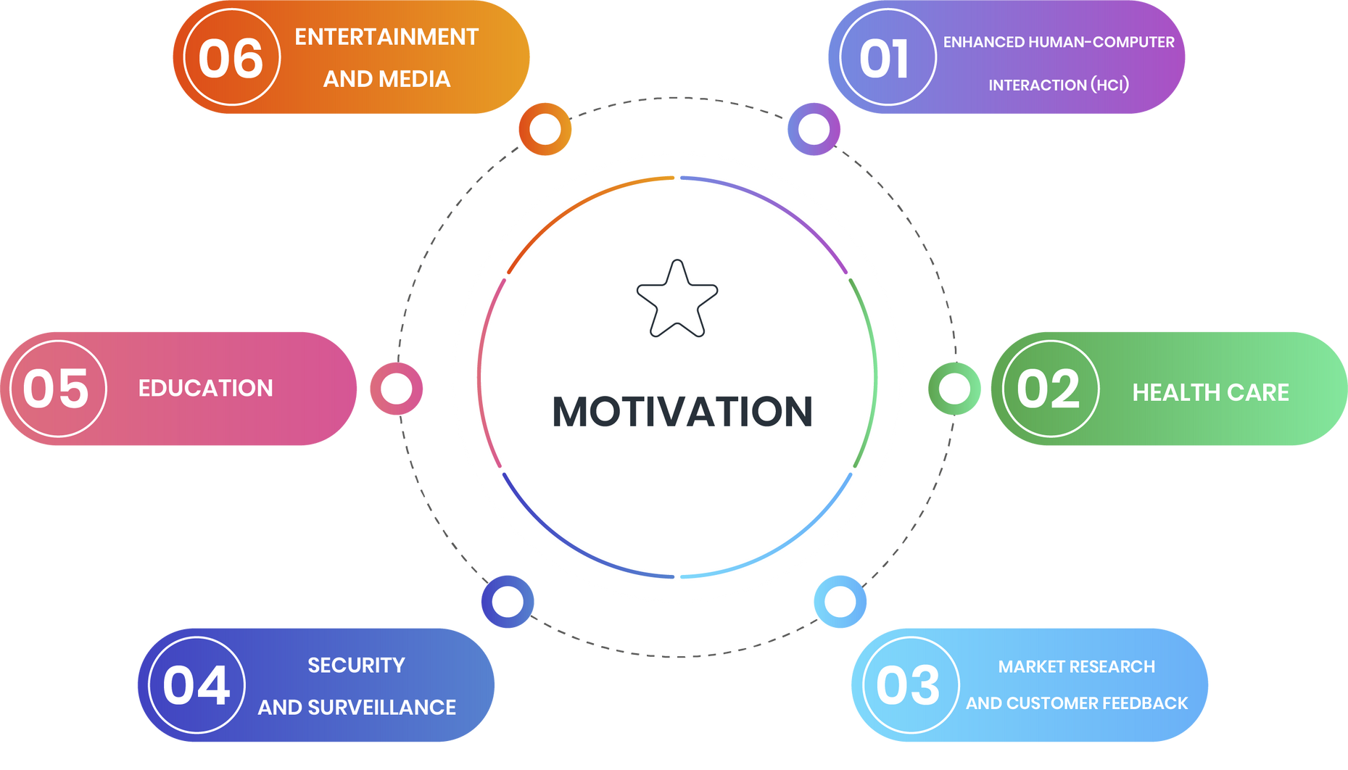
Cont`d

Slide 7

Problem Definition
01
Background and Context
02
Key Challenges
03
Changing Environmental Conditions
04
Large and Diverse Data
05
System Speed and Accuracy

Slide 8



Cont`d
Background and Context
Key Challenges
Changing Environmental Conditions
Facial Expression Recognition (FER) technology, part of AI and computer vision, analyzes facial expressions to identify emotions. It is applied in areas like human-computer interaction, healthcare, education, entertainment, security, and surveillance. However, FER faces challenges in achieving high accuracy and efficiency.
Variability in Human Expressions:
Facial expressions vary significantly among individuals based on age, gender, cultural background, and personal traits.
The need for a system capable of adapting to these differences to achieve high accuracy.
Lighting, angles, distances, and backgrounds can greatly affect recognition accuracy.
The need for advanced image processing and enhancement techniques to overcome these challenges.

Slide 9



Cont`d
System Speed and Accuracy
Large and Diverse Data
Collecting, classifying, and processing large amounts of facial data to enhance model training.
Ensuring that the data used is diverse and comprehensive to represent all categories fairly.
Meeting real-time requirements, especially in critical applications such as security and surveillance.
Achieving a balance between high accuracy and processing speed.

Slide 10
Methodology
(Part 1)
01
Data Collection
02
Preprocessing
03
Classification
04
Evaluation
05
Test & Prediction
06
Analysis & Design

Slide 11


Data Collection
Collect a large dataset of facial images with different emotions. We used The (CKP) Facial Expression Database is a well-known dataset used in the field of Facial Emotion Recognition (FER), including seven classes such as Angry, Fear, Happy, contempt, Sad, Surprise and Disgust.

Slide 12
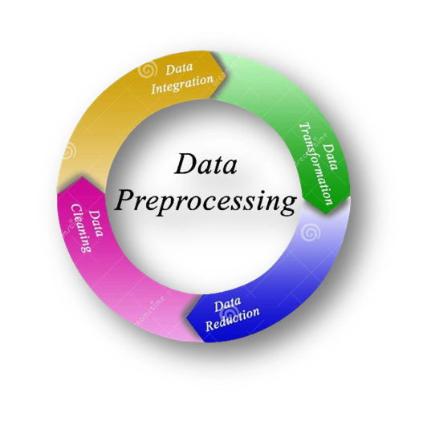
Preprocessing
Preprocess the collected data by resizing, cropping, duplicating, transforming RGB to grayscale and normalizing the images to ensure consistency in the dataset.

Slide 13
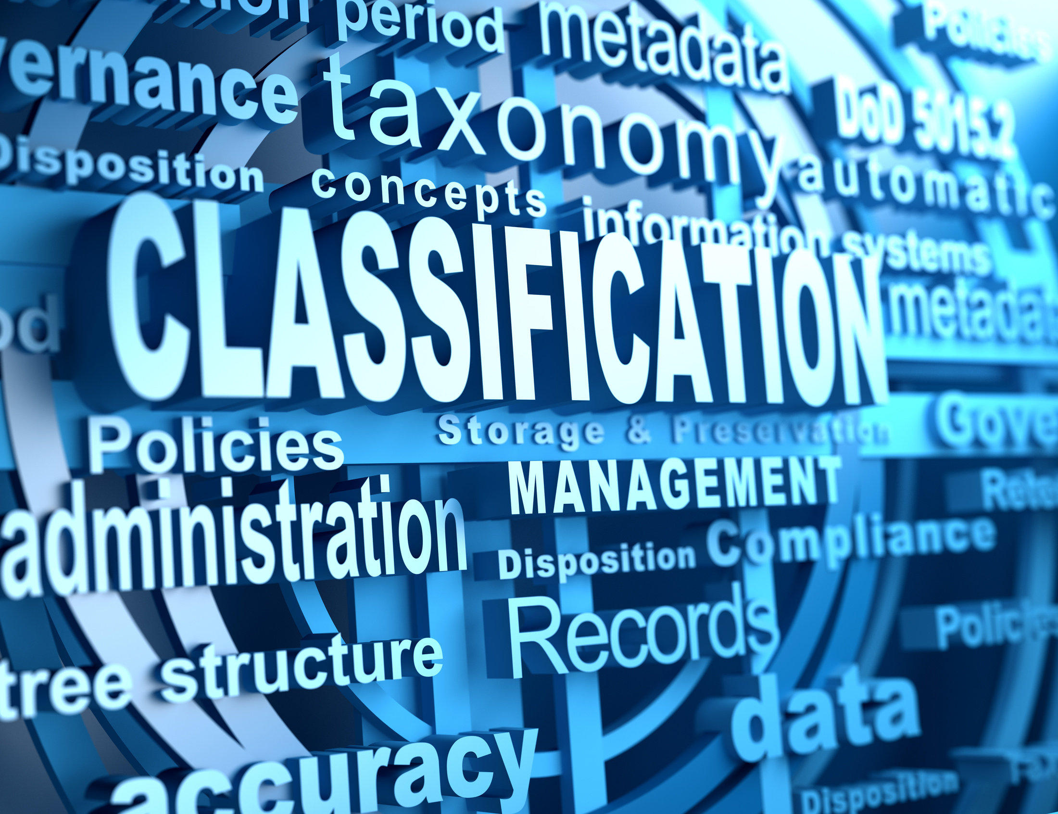
Classification
Train a deep learning algorithm such as Convolutional Neural Networks (CNN)
CNN stands for Convolutional Neural Network. It is a type of deep learning model commonly used in image and video recognition tasks. CNNs are designed to automatically and adaptively learn spatial hierarchies of features from input images, which makes them highly effective for computer vision applications.

Slide 14

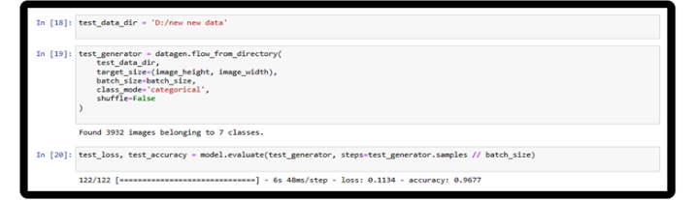
Evaluation
In the end, after using the CNN and training the model on the dataset, we evaluated the accuracy of all category accuracy of 96% as shown in the figure

Slide 15
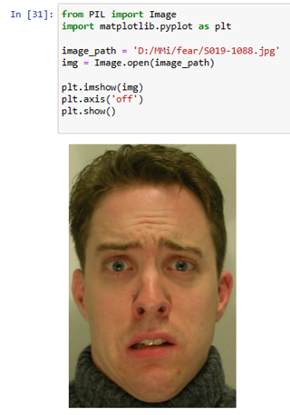
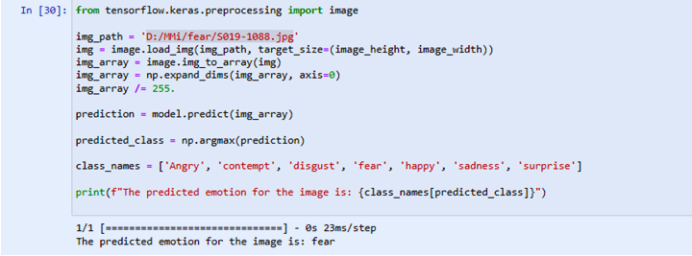
Test & Prediction
Load a new image, preprocess it in the same way as the training data, and predict its class using the trained model.

Slide 16
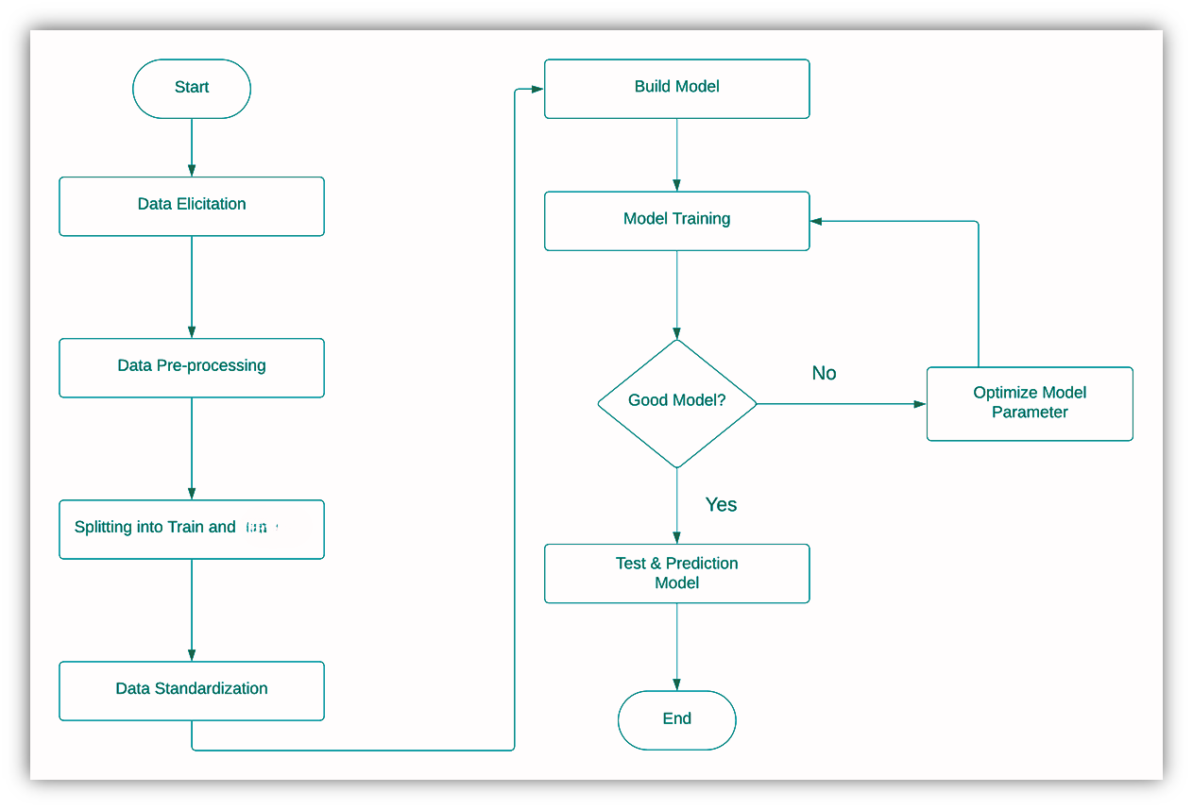

Analysis & Design
Flowchart:
Validation

Slide 17
Methodology
(Part 2)
Building a model using Teachable Machine
01
02
Creating a mobile application
03
Link it using TensorflowLite

Slide 18
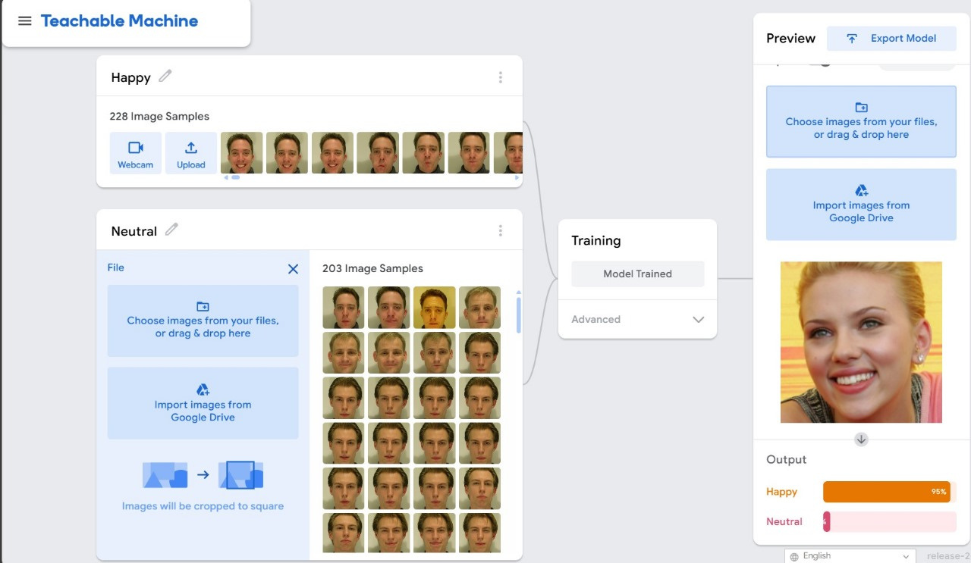
Building a model using Teachable Machine

Slide 19
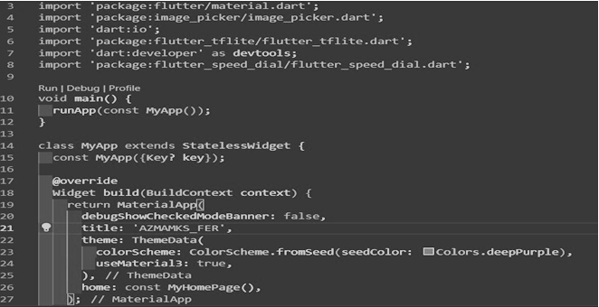
Creating a mobile application

Slide 20
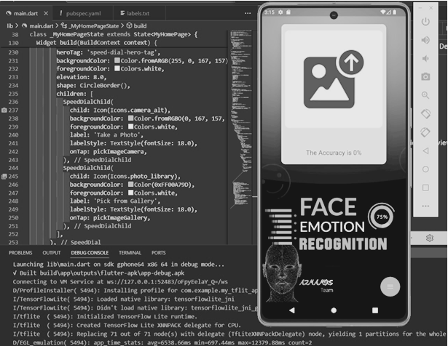
Cont`d

Slide 21

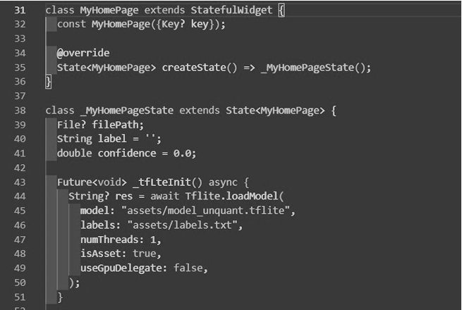

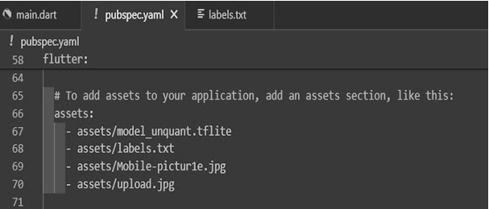
Link it using TensorflowLite

Slide 22
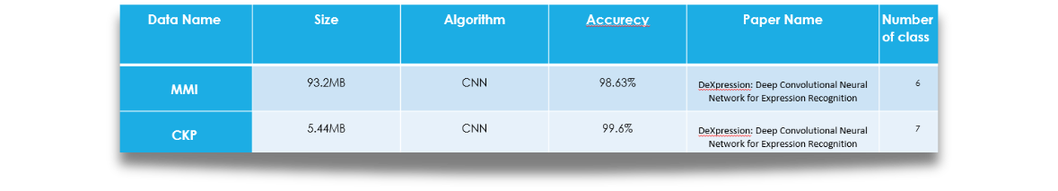
Related Work

Slide 23
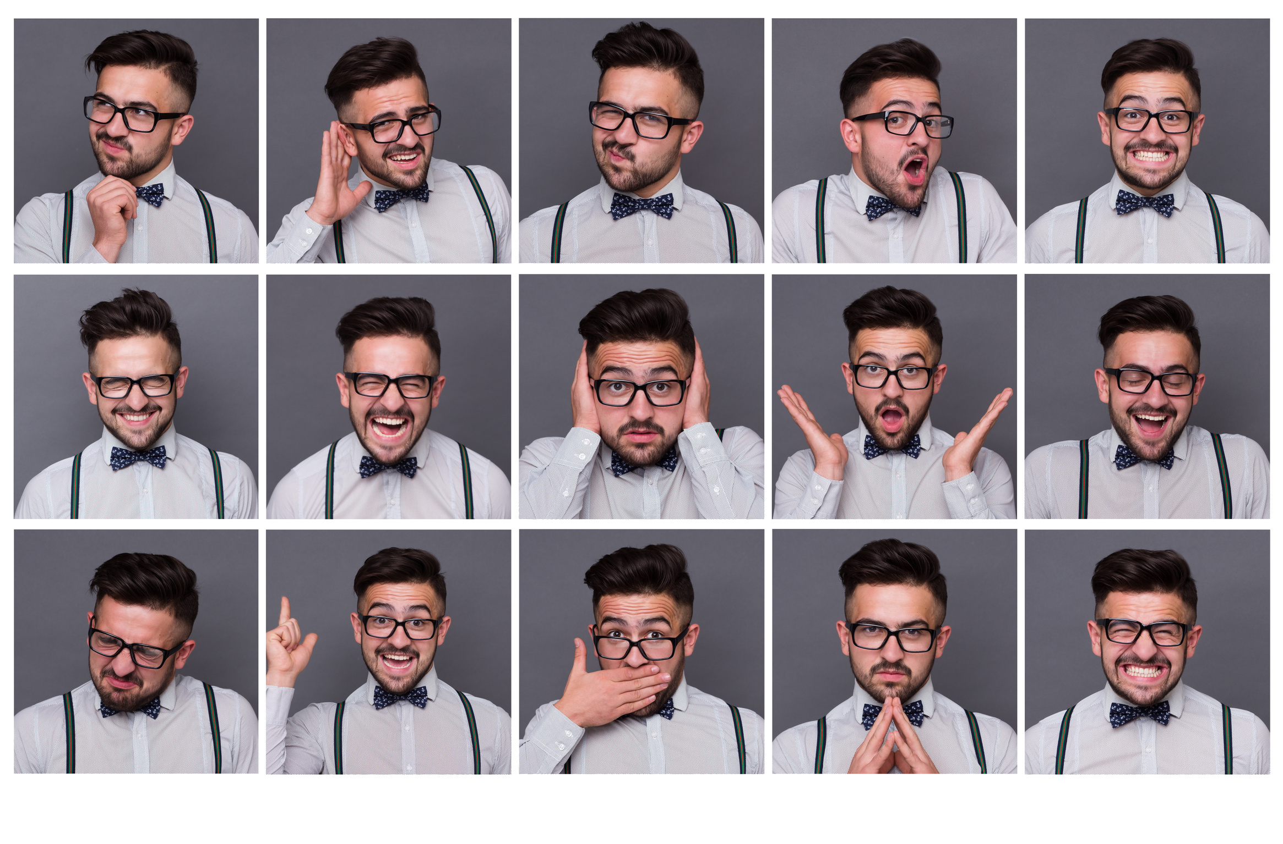
Future Work
Expand the application to detect and recognize the emotions of multiple individuals within the frame simultaneously.
Enhance the app to not only recognize basic emotions but also classify their intensity levels (e.g., mild sadness versus intense sadness).

Slide 24

Conclusion
The conclusion summarizes the successful creation of a facial expression recognition model in Python using various libraries and a successful mobile application works efficiently.

Slide 25
THANK YOU

